Slide 1
Mathematics for Intelligent Systems - 5
TEAM 7

Slide 2
TEAM 7
NAME | ROLL NUMBER
DINESH KUMAR M R | CB.EN.U4AIE20011
JANGALA GOUTHAMI | CB.EN.U4AIE20023
K S PAVAL | CB.EN.U4AIE20047
SHREYA SANGHAMITRA | CB.EN.U4AIE20066
N T SHRISH SURYA | CB.EN.U4AIE20067

Slide 3
Page - Rank Algorithm
Markov Chain

Slide 4
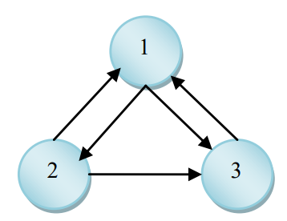
Web Graph
PageRank treats the Web as a directed, labelled graph
The graph's nodes are the pages, and the edges are the hyperlinks between them.
If an incoming link comes from a reputed page, then that incoming link is given a higher weighting than the incoming links from non-reputed pages.

Slide 5
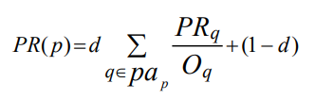
Page Rank
The page rank of a page p can by computed by
Where d is the damping factor
O_{q} is the number of outgoing links of page q

Slide 6
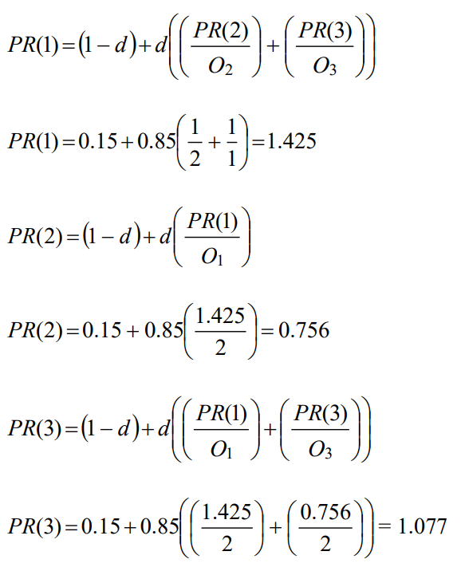
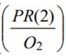
Example

Slide 7
Use of Markov Chain in Page Rank
Imagine a random surfer surfing the Web, going from one page to another page by randomly choosing an outgoing link from one page to go to the next one.
This theoretical random walk is known as Markov chain or Markov process.

Slide 8
Use of Markov Chain in Page Rank
The irreducibility guarantees the existence of a unique PageRank vector q
The power method with a primitive stochastic repetition matrix will always converge to q independent of the starting vector
Irreducible: Markov chain is irreducible if there is a non-zero probability of transitioning from any state to any other state.
Aperiodic:
An irreducible Markov chain with a primitive transition matrix is called as aperiodic chain.
A state has period k if it returns to that state in multiples of k moves. If k=1, the state is aperiodic.

Slide 9
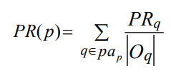
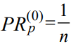
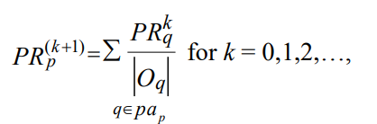
Basic Page Rank
Initial Value

Slide 10
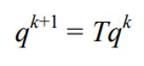
Matrix Notation
q^{k} is the PageRank vector at kth iteration
And T is the transition matrix
Unfortunately, this has convergence problems i.e. it can cycle or the limit may be dependent on the starting vector.

Slide 11
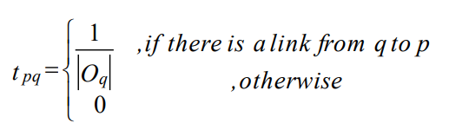
Transition matrix
If there are n pages on the Web, T is an n x n matrix such that t_{pq} is the probability of moving from page q to page p in a time interval.

Slide 12
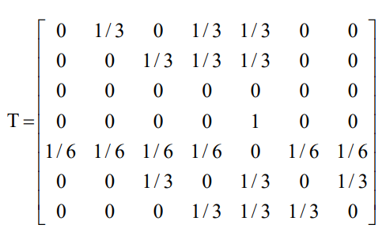
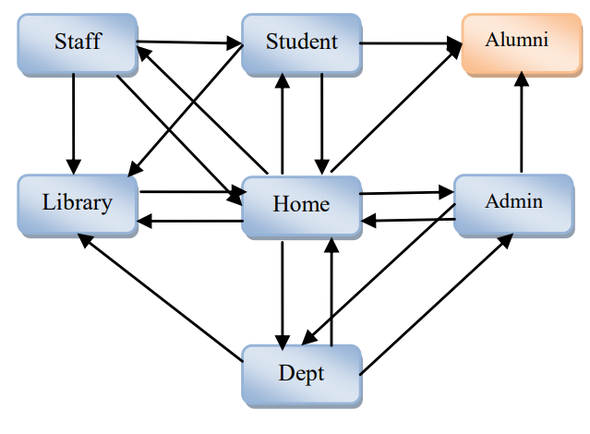
Example

Slide 13
In the transition matrix T, a row q has non-zero elements in positions that correspond to forward links to page q and column p has non-zero elements in positions that correspond to back links to page p. If page q has forward links, the sum of row is equal to 1.
Example: In row one,
1/3 + 1/3 + 1/3 = 1

Slide 14
Dangling node
In the transition matrix, if sum of any rows is zero that indicates that there is a page with no forward links. This type of page is called as dangling node or hanging node.
Example: row 3

Slide 15
Implementation and codes

Slide 16
Graphs used
Nx Karate Club Graph
Nx Davis southern women graph
Nx Florentine Families graph

Slide 17
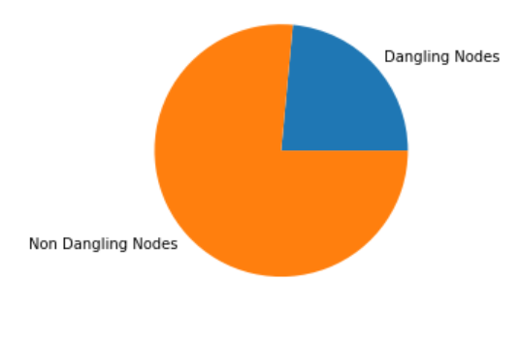
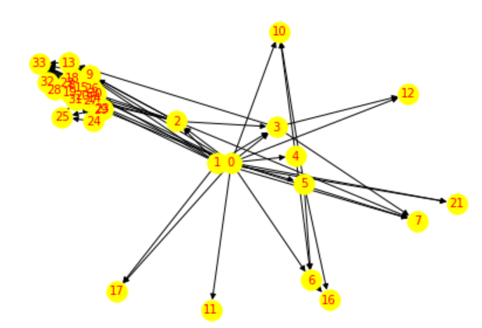
Karate Club Graph
The dataset is a network of friendships between the 34 members of a karate club at a US university, as described by Wayne Zachary in 1977.
34 nodes and 78 edges
Number of Dangling Nodes: 8 Number of

Slide 18
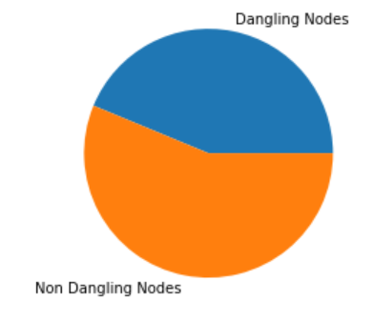
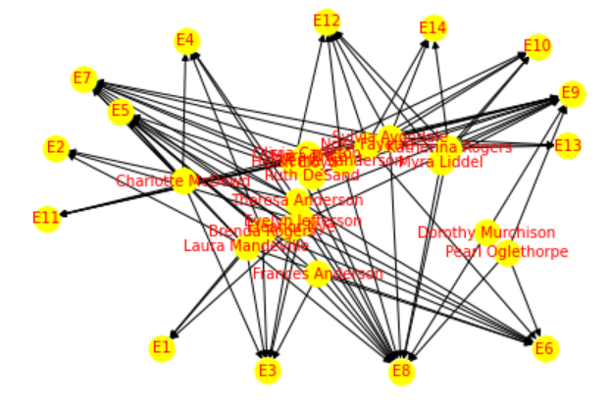
Davis Southern Women Graph
This is a data set of 18 women observed over a nine-month period. During that period, various subsets of these women met in a series of 14 informal social events. The data recorded which women met for which events.
Number of nodes: 32
Number of edges: 89
Number of Dangling Nodes: 14
Number of Non Dangling Nodes: 18

Slide 19
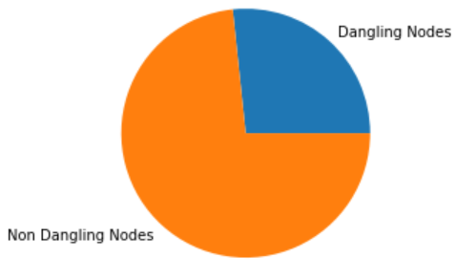
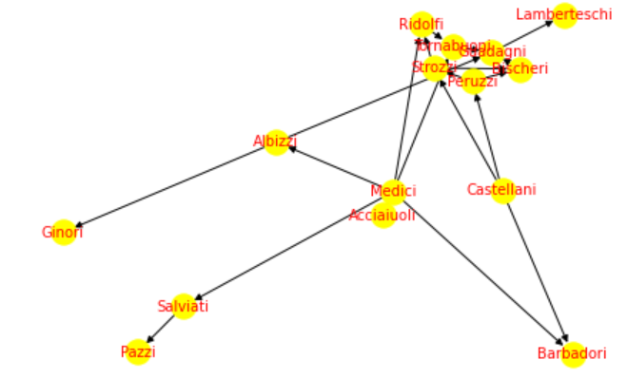
Florentine Families Graph
Depicts the alliances among Renaissance Florentine families, as established by marriage ties.
Number of nodes: 15
Number of edges: 20
Number of Dangling Nodes: 4
Number of Non Dangling Nodes: 11

Slide 20
Contents
Handling Dangling Nodes:
1
Using Teleportation
Using Personalisation Vector
Dangling Node Transition
Dangling node mass redistribution
Handling Convergence Issues:
2
Using Damping Factor
Increasing iterations
Using a stopping criterion
Dealing with disconnected components
3
Handling "Teleportation" or "Random Jumps"
4

Slide 21
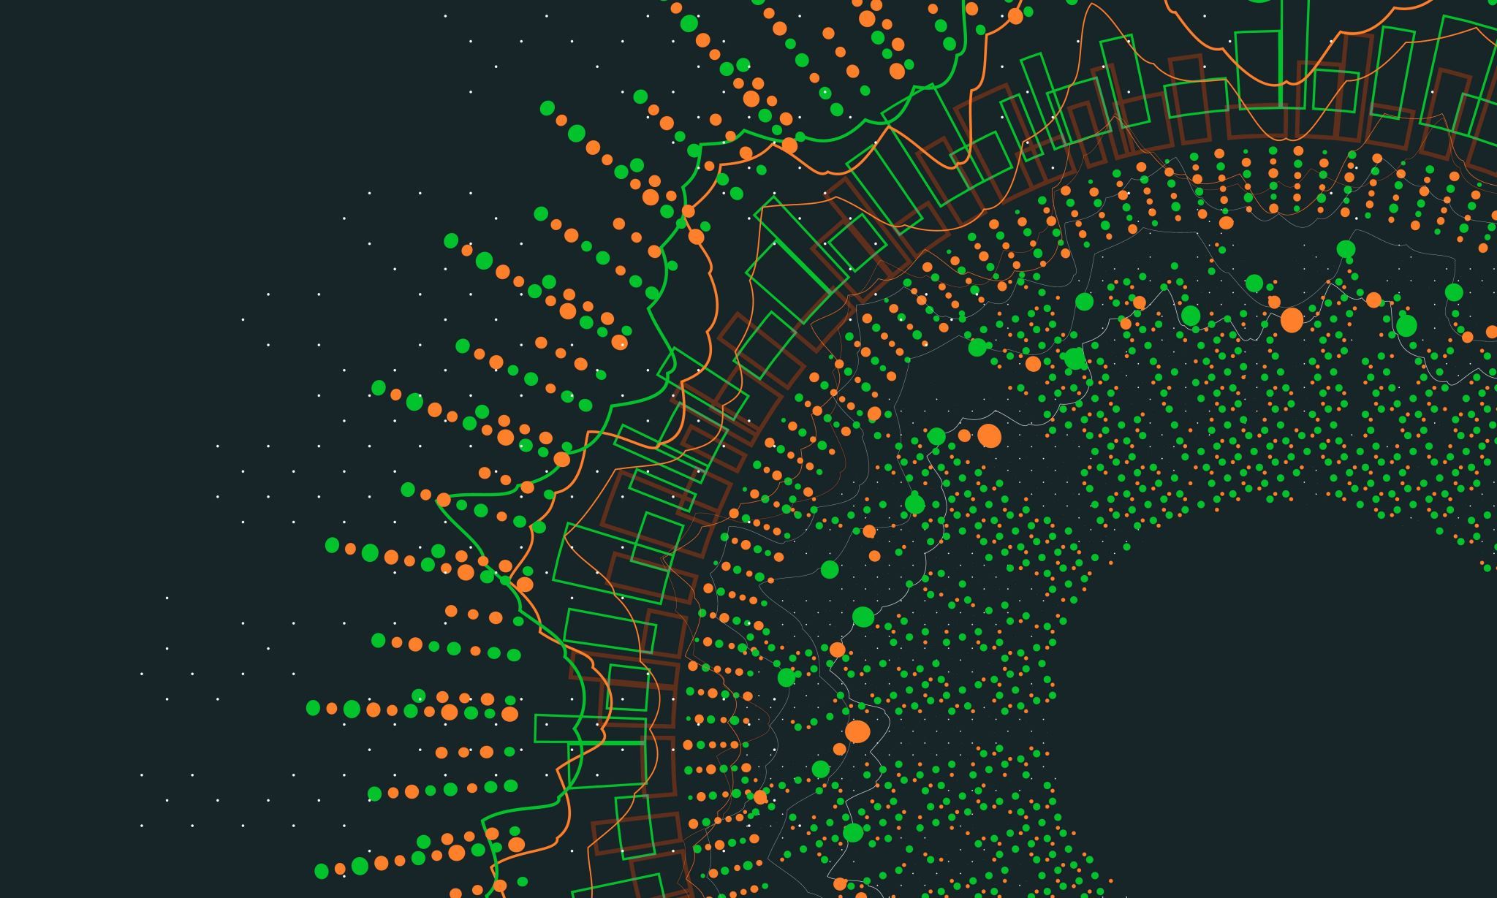
Handling Dangling Nodes

Slide 22
Using Teleportation
Jump to any node
Here, we have set the teleportation probability to 0.1
This probability is often set to a small value, such as 0.1, to ensure that the random walker can explore the graph effectively.
Notes:
The terms "damping factor" and "teleportation" are often used interchangeably in the context of the PageRank algorithm, but they refer to slightly different things.
The damping factor is a scalar value, typically denoted as "alpha" that is used to control the amount of "randomness" or "teleportation" in the PageRank algorithm. It is a probability that at each step of the algorithm, the random surfer will follow a link from the current page to another page, rather than randomly jumping to any page in the network. A higher value of alpha results in less randomness and more reliance on the link structure of the network. A common value for alpha is 0.85
Teleportation, on the other hand, is the probability that at each step of the algorithm, the random surfer will randomly jump to any page in the network, rather than following a link from the current page. It is used to handle the issue of "dangling nodes" in the network, which are pages with no outgoing links. Without teleportation, the PageRank of pages that are only reachable through a dangling node would be zero. To fix this, the teleportation probability is used to redistribute the PageRank of dangling nodes among all pages in the network. The teleportation probability is usually set to (1-alpha) / N where N is the number of nodes in the network.
So, the damping factor and teleportation are related but different concepts. Damping factor controls the probability of following a link, while teleportation controls the probability of jumping to any page in the network.

Slide 23
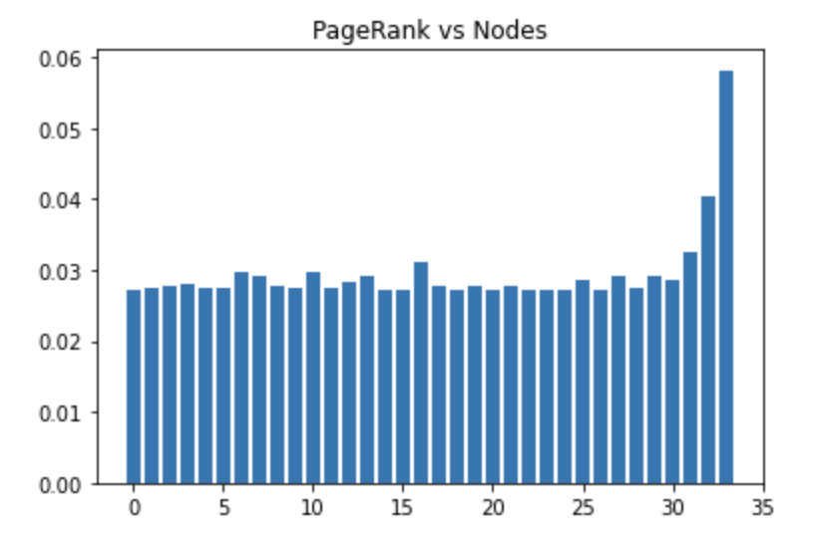
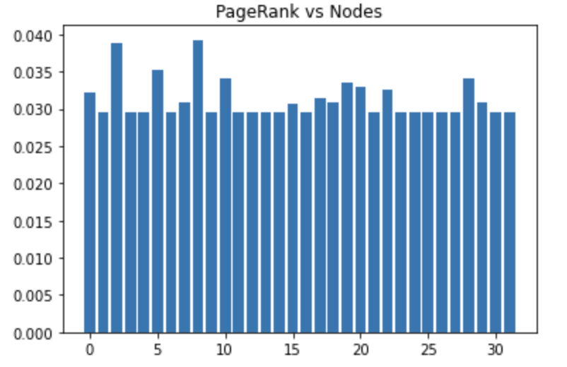
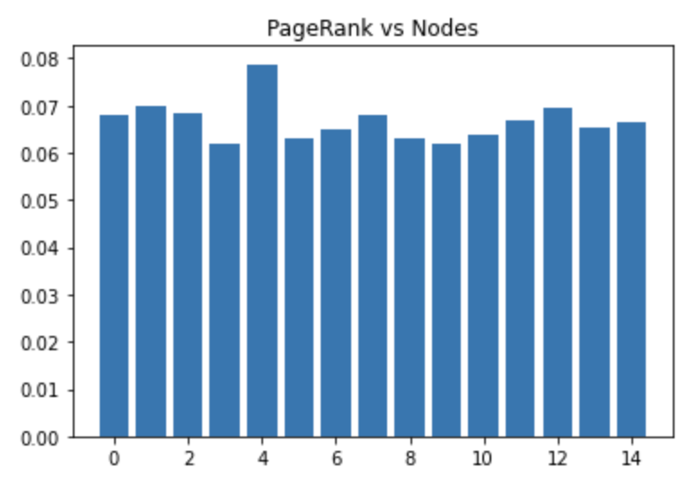
Results
Graph 1 Graph 2 Graph 3

Slide 24
Using personalisation vector
A personalization vector in PageRank algorithm is a way to give a specific set of nodes a higher or lower importance than the rest of the nodes in the graph.
It is a way to bias the PageRank algorithm to give higher scores to certain nodes.
It is a probability distribution over the nodes of the graph, where the probability of each node represents the importance of that node.

Slide 25
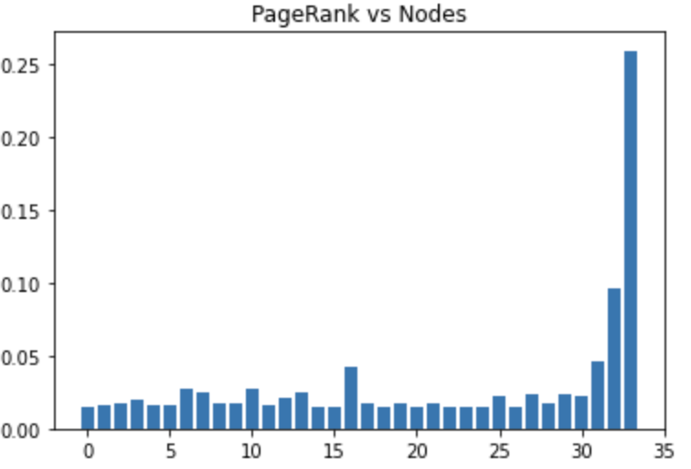
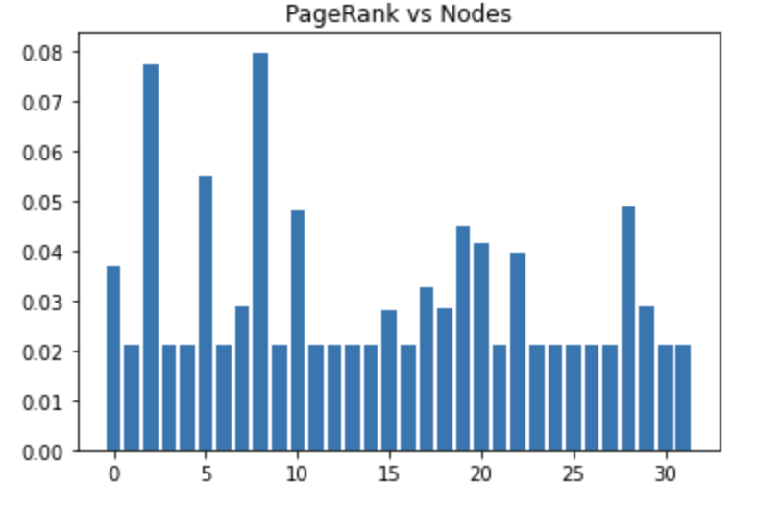
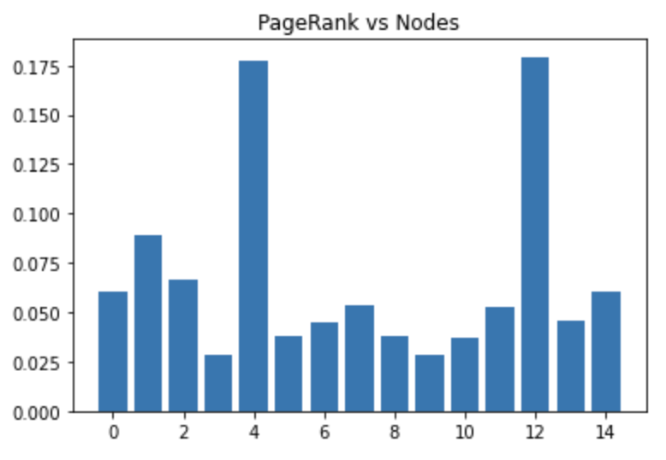
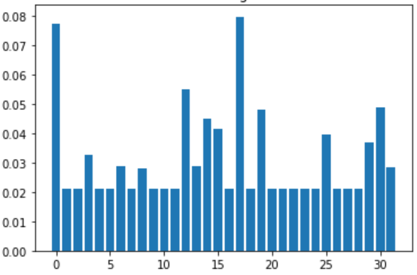
Results
Graph 1 Graph 2 Graph 3

Slide 26
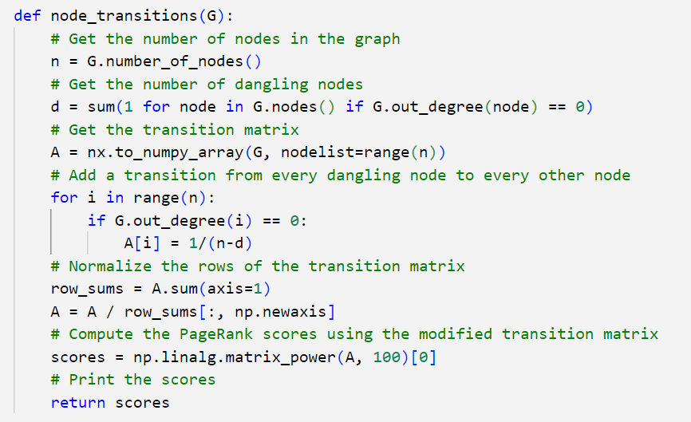
Using Dangling Node Transition
Redistributing the probability mass of the dangling nodes to all other nodes in the graph.​
Add a transition from every dangling node to every other node in the graph with a probability of 1/(n-d)

Slide 27
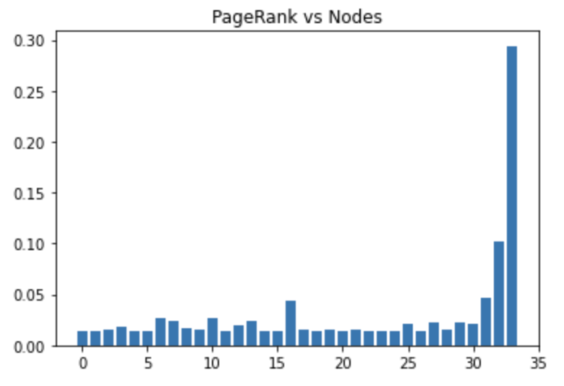
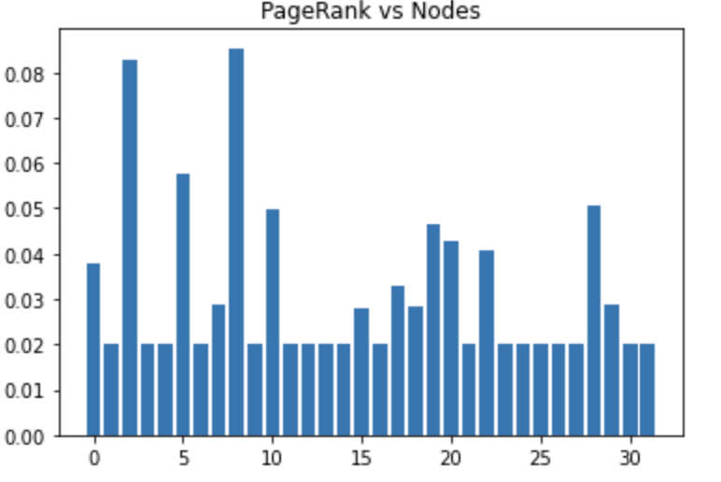
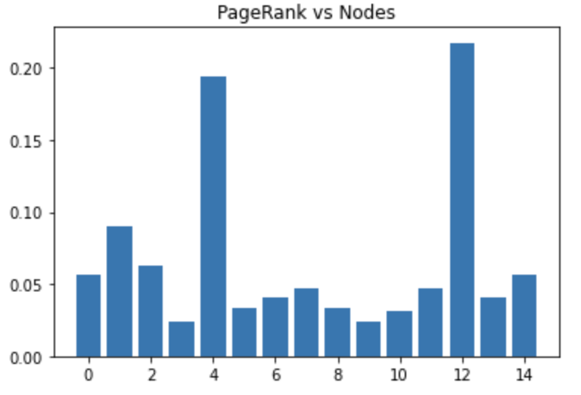
Results
Graph 1 Graph 2 Graph 3

Slide 28
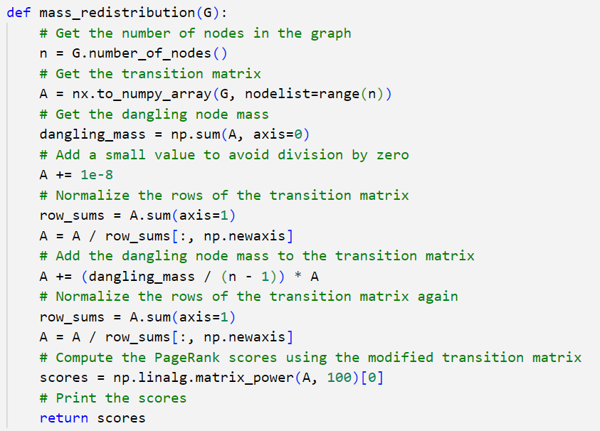
Using Dangling Node mass Redistribution
Redistributes it to a specific set of nodes.

Slide 29
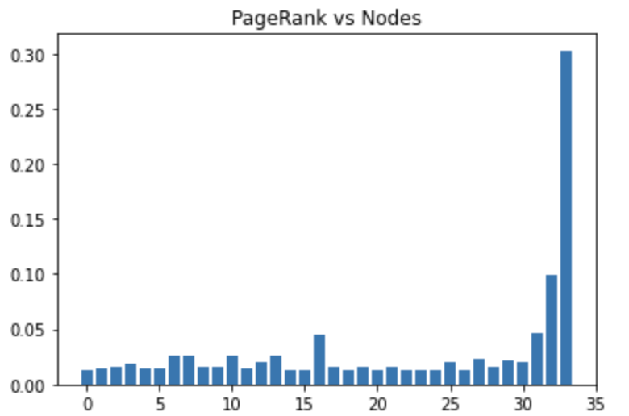
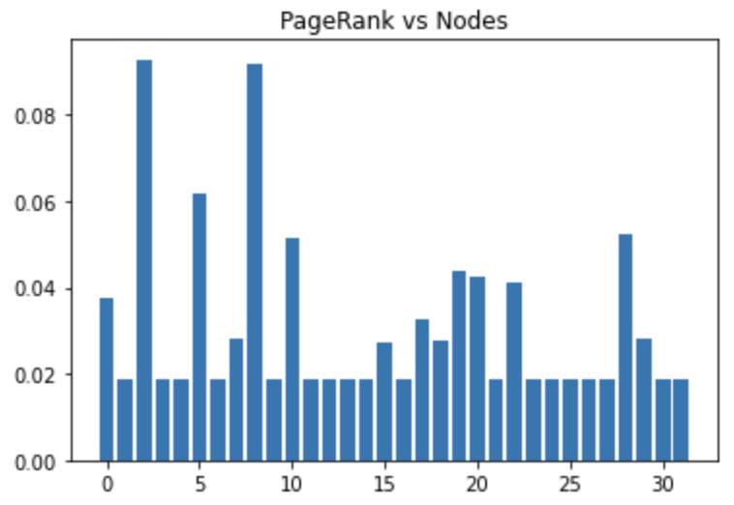
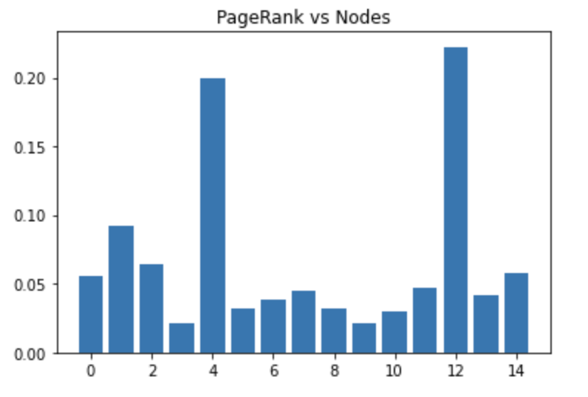
Results
Graph 1 Graph 2 Graph 3

Slide 30
Handling Convergence Issues

Slide 31
What is Convergence?
Convergence refers to the point at which the algorithm reaches a stable state and the rank of each page in a network no longer changes.
The PageRank algorithm assigns a "rank" or importance score to each page in a network (such as a website), based on the number and quality of links pointing to that page.

Slide 32
Using Damping Factor
A higher damping factor will cause the random walker to move more slowly, which can help the algorithm converge faster.
A lower damping factor will cause the random walker to move more quickly, which can help the algorithm explore the graph more thoroughly but may make it converge slower.
Damping factor considered here is 0.85.

Slide 33
Equation
PR(u) = (1-d) + d(PR(v)/L(v))
where:
PR(u) is the PageRank score of node u
d is the damping factor (usually set to 0.85)
PR(v) is the PageRank score of neighbouring node v
L(v) is the number of outgoing links from node v.

Slide 34
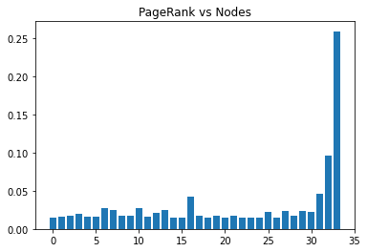
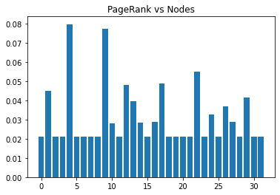
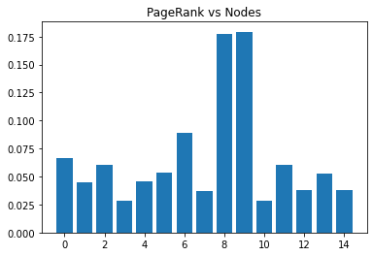
Results
Converged at 33 iterations...
Converged at 31 iterations...
Converged at 14 iterations...
Graph 1 Graph 2 Graph 3

Slide 35
Increasing number of Iterations
In case convergence is not achieved in a limited number of iterations, we can increase the number of iterations to allow it to converge.
Since our graph converge at small values like 33, 31 and 14, increasing the number of iterations gives us the same results.
This might be useful for larger datasets.

Slide 36
Results
Converged at 33 iterations...
Converged at 31 iterations...
Converged at 14 iterations...
Graph 1 Graph 2 Graph 3

Slide 37
Using a Stopping Criterion
A stopping criterion is a condition or set of conditions that determine when the PageRank algorithm should stop iterating.
The most common stopping criterion used in the PageRank algorithm is based on the change in the rank of each page between iterations.
Once the change in rank for all pages falls below a certain threshold, the algorithm is stopped.

Slide 38
Using a Stopping Criterion
A smaller tolerance value will cause the algorithm to stop when the difference between the PageRank scores of two consecutive iterations is smaller.
This will make the algorithm converge more quickly, but it will also increase the computational cost of the algorithm.

Slide 39
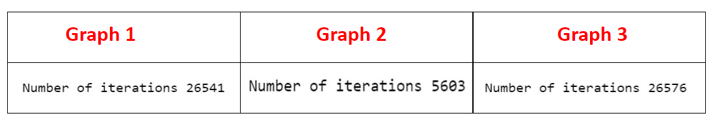
Results

Slide 40
Dealing with Disconnected Components

Slide 41
No path between any nodes
Page rank algorithm doesn’t work when dealing with disconnected nodes.
Assumption by the algorithm: There is a path between any two nodes
How to overcome this??
Teleportation
Ensures that the algorithm does not struck
Notes:
When dealing with disconnected components in a graph, the PageRank algorithm will not work as expected since the algorithm assumes that there is a path between any two nodes.
You can add a small probability of "teleportation" to a randomly chosen node in the graph. This can help to ensure that the algorithm does not get stuck in a disconnected component and can explore other parts of the graph.

Slide 42
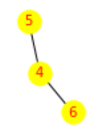
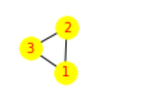
Example

Slide 43
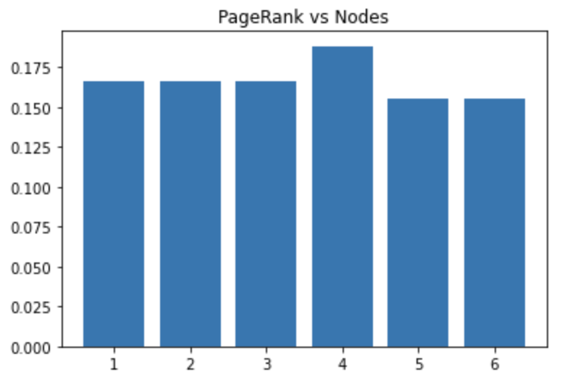
Result

Slide 44
Handling Teleportation or Random jumps

Slide 45
Allows the algorithm to escape from local optima and converge to a global solution.
Teleportation is the process of jumping from a node to a randomly chosen node in the graph.
The probability of teleporting from a node to any other node is controlled by the damping factor.
Notes:
Handling teleportation and random jumps in the PageRank algorithm is important because it allows the algorithm to escape from local optima and converge to a global solution.
Teleportation is the process of jumping from a node to a randomly chosen node in the graph.
The probability of teleporting from a node to any other node is controlled by the damping factor.
This can be done by adding a teleportation probability to the transition matrix. The teleportation probability represents the probability that the random surfer will jump to a random page, rather than following links in the graph.
We handle "teleportation" or "random jumps" in a Markov chain PageRank algorithm because it helps to avoid getting stuck in cycles and ensures that the algorithm converges to a steady state solution. In a Markov chain, without teleportation, the algorithm can get stuck in cycles, where pages keep referring to each other and the algorithm never reaches a steady state
Teleportation allows the algorithm to escape these cycles by introducing a small probability of jumping to a randomly chosen page, rather than always following links. This ensures that the algorithm visits all pages eventually, and converges to a steady state solution.

Slide 46
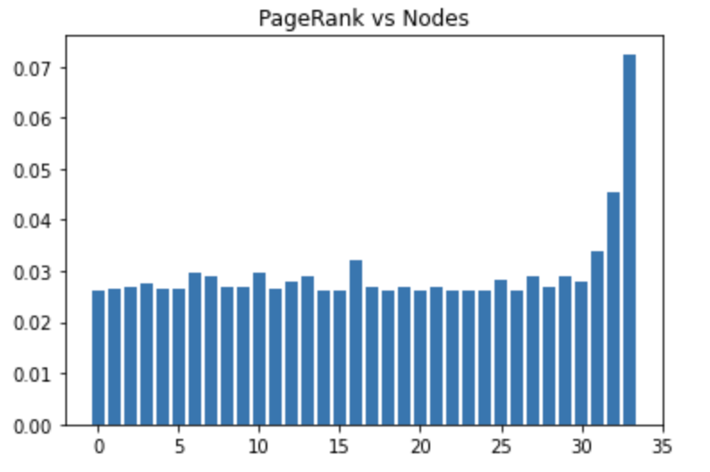
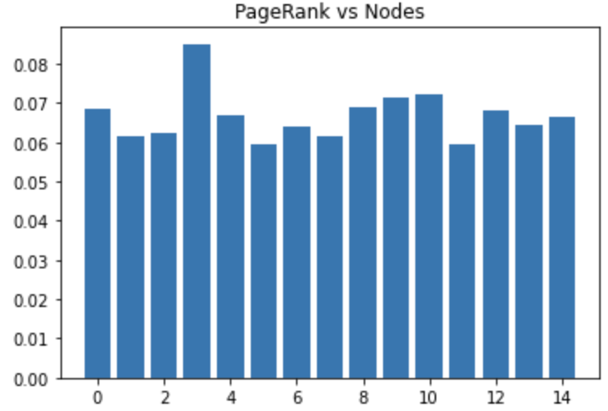
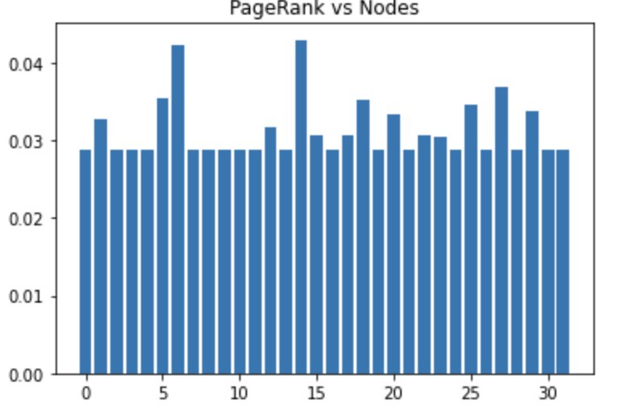
Results
Graph 1 Graph 2 Graph 3

Slide 47
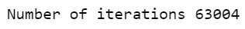
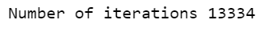
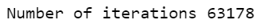
Results
The number of iterations is extremely large because the tolerance is set very low (1e-8). This means that the loop will continue to iterate until the difference between the new scores and the previous scores is less than 1e-8.

Slide 48

Page-Rank importance Graphs:

Slide 49
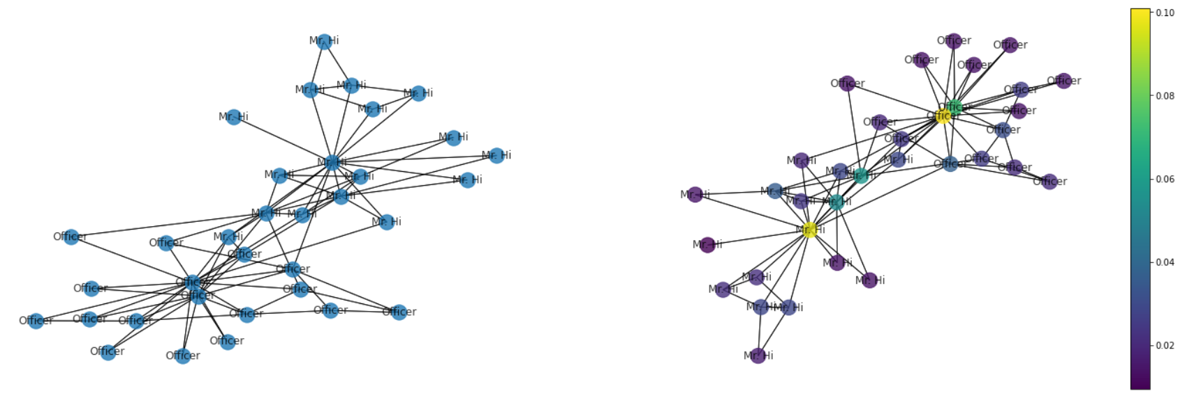
Karate Club Graph

Slide 50
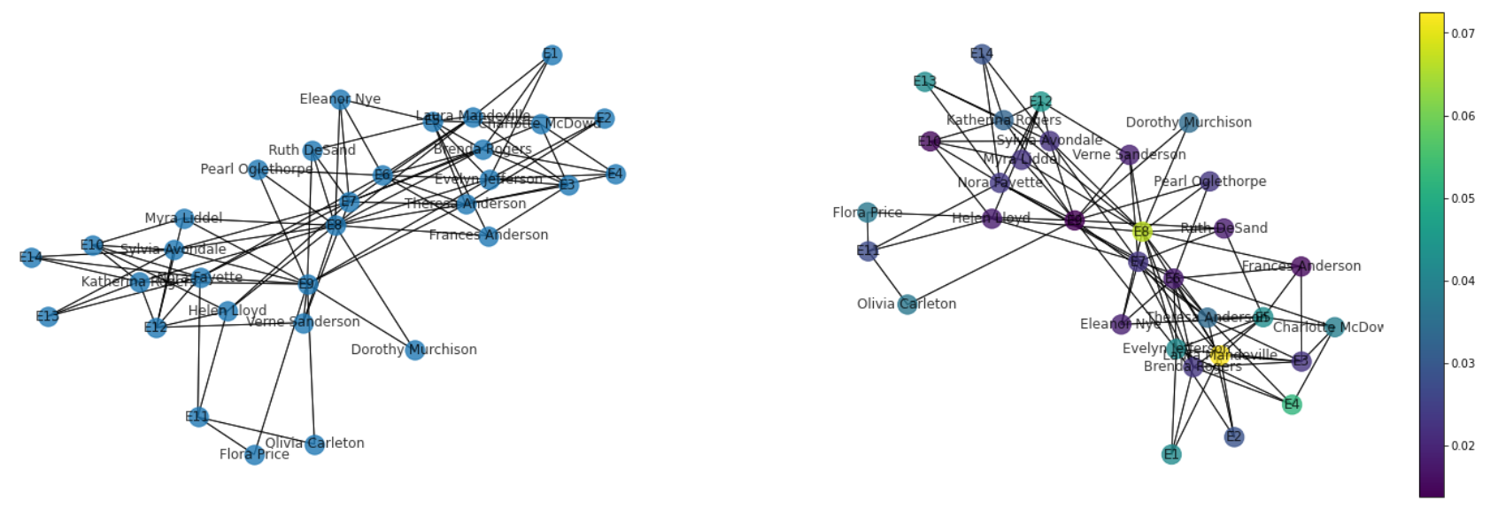
Davis Southern Women Graph

Slide 51
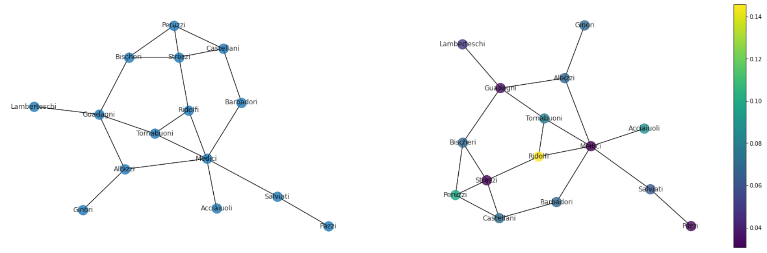
Florentine Families Graph

Slide 52

Thank You

